Slide 1
Chapter 4
Data Link Control Protocols
4.<number>

Slide 2
4-1 FRAMING
The data link layer needs to pack bits into frames, so that each frame is distinguishable from another.
There are two types of framing protocols:
Character-oritented protocol
Bit-oriented protocol
4.<number>

Slide 3

Figure 4.3 A frame in a bit-oriented protocol
4.<number>

Slide 4

Note
Bit stuffing is the process of adding one extra 0 whenever five consecutive 1s follow a 0 in the data, so that the receiver does not mistake
the pattern 01111110 for a flag.
4.<number>

Slide 5

Figure 4.4 Bit stuffing and unstuffing
4.<number>

Slide 6
4-2 FLOW AND ERROR CONTROL
The most important responsibilities of the data link layer are flow control and error control. Collectively, these functions are known as data link control.
4.<number>

Slide 7
Note
Flow control refers to a set of procedures used to restrict the amount of data
that the sender can send before
waiting for acknowledgment.
4.<number>

Slide 8
Note
Error control in the data link layer is the process to detect error and and retransmit the corrupted frames.
4.<number>

Slide 9

Figure 4.5 Taxonomy of protocols discussed in this chapter
4.<number>

Slide 10
Note
Stop and wait ARQ
4.<number>

Slide 11
Note
Rule1: sender keeps a copy of sent frame until successful delivery is ensured.
Rule 2: receiver responds with an ack when it successfully receives a frame
Rule 3: both data and ack frames must be numbered: 0 or 1
Rule 4: when sender does not receive an ack within certain time, it assumes frame is lost, then retransmits the same frame.
4.<number>

Slide 12

Figure 4.7 Flow diagram for Stop and Wait ARQ
4.<number>

Slide 13
Note
Go back N ARQ
4.<number>

Slide 14
Note
Rule 1: Allows multiple frames to be sent before waiting for ACK. Frames must be received in correct order.
Rule 2: If a frame is lost, the lost frame and all of the following frames must be retransmitted.
Rule 3: Frame header contains m bits for sequence number that allows up to 2^m different frame numbers.
Rule 4: Sending more than one frame at once requires sender to buffer multiple frames Known as "sending window"
4.<number>

Slide 15

Figure 4.12 Send window for Go-Back-N ARQ
4.<number>

Slide 16

Figure 4.13 Receive window for Go-Back-N ARQ
4.<number>

Slide 17

Figure 4.16 Flow diagram for Go back N ARQ
4.<number>

Slide 18

Figure 4.17 Flow diagram for Go back N ARQ
4.<number>

Slide 19
Note
Selective Repeat ARQ.
4.<number>

Slide 20
Note
Rule1: Allow frames to be received out of order.
Rule 2: Receiving window >1
4.<number>

Slide 21

Figure 4.18 Send window for Selective Repeat ARQ
4.<number>

Slide 22

Figure 4.19 Receive window for Selective Repeat ARQ
4.<number>

Slide 23

Figure 4.23 Flow diagram for Selective Repeat ARQ
4.<number>

Slide 24
4-3 HDLC
High-level Data Link Control (HDLC) is a bit-oriented protocol for communication over point-to-point and multipoint links. It implements the ARQ mechanisms we discussed in this chapter.
4.<number>

Slide 25
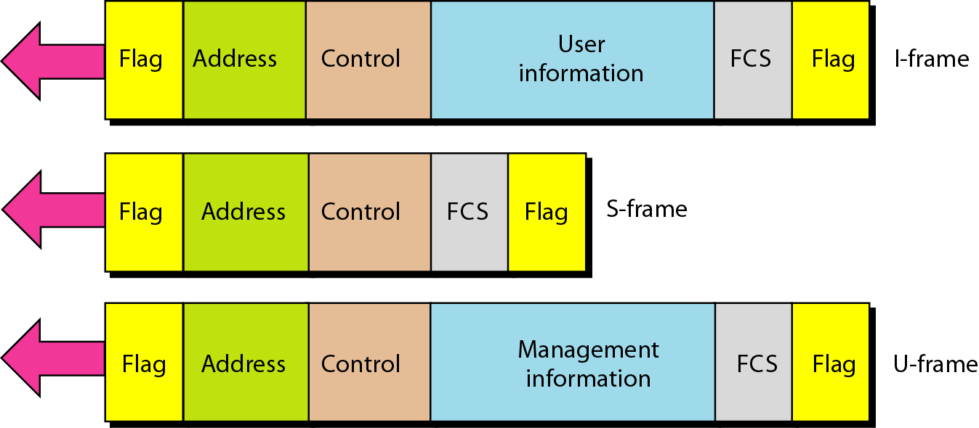
Figure 4.27 HDLC frames
4.<number>

Slide 26
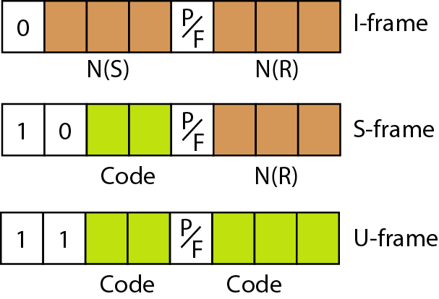
Figure 4.28 Control field format for the different frame types
4.<number>

Slide 27
Note
S-frame:
Code 00: Receive ready (RR).
Code 10: Receive not ready (RNR).
Code 01: Reject
Code 11: Selective Reject
4.<number>

Slide 28
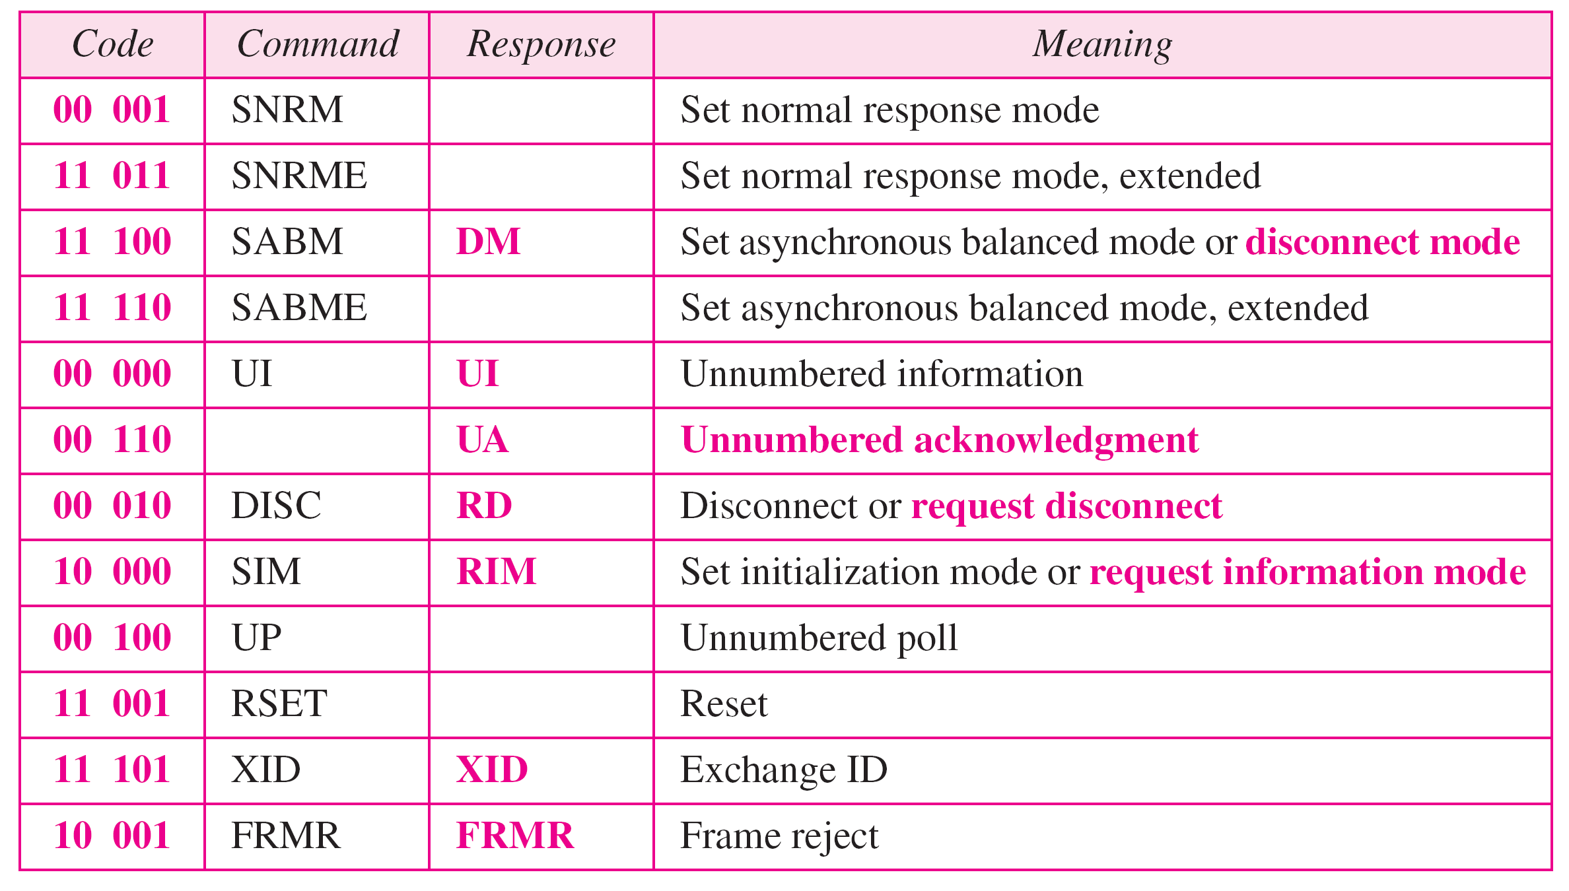
Table 4.1 U-frame control command and response
4.<number>

Slide 29
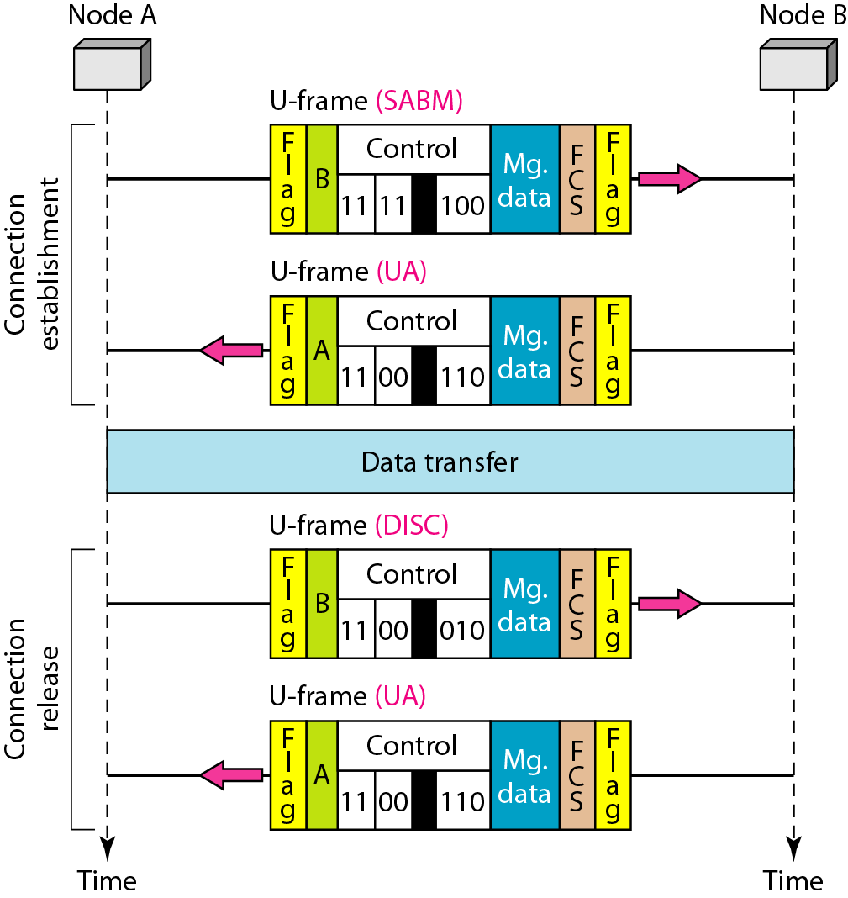
Figure 4.29 Example of connection and disconnection
4.<number>

Slide 30
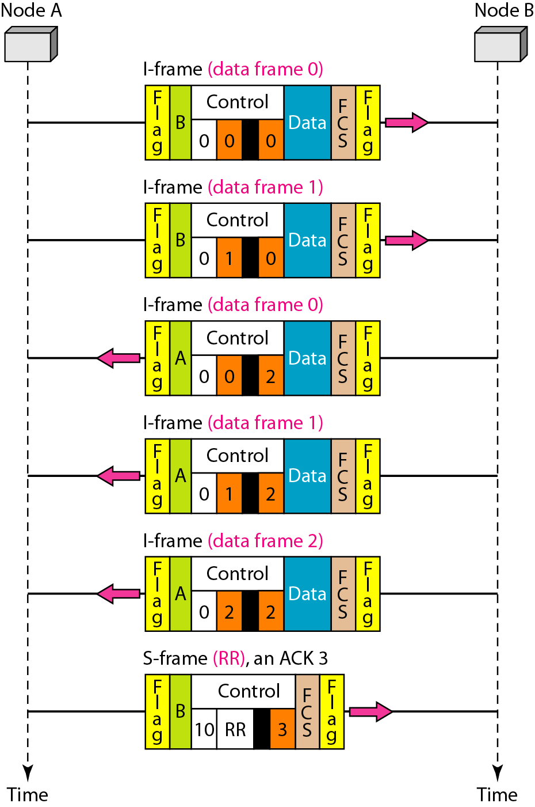
Figure 4.30 Example of piggybacking without error
4.<number>

Slide 31
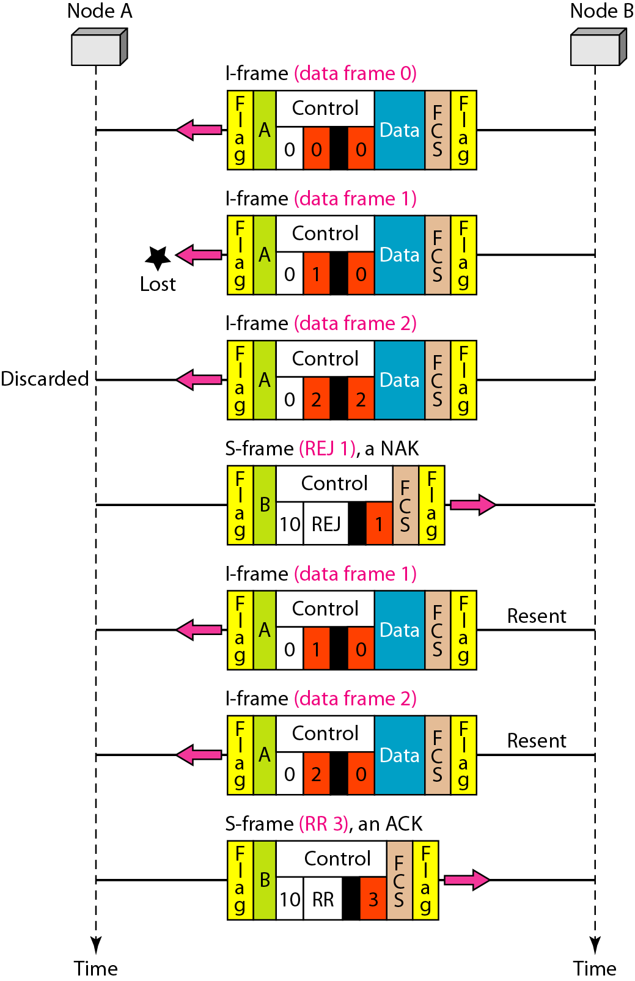
Figure 4.31 Example of piggybacking with error
0
Sửa 2-> 0S
4.<number>

Slide 32
4-4 STANDARD ETHERNET
The original Ethernet was created in 1976 at Xerox’s Palo Alto Research Center (PARC). Since then, it has gone through four generations. We briefly discuss the Standard (or traditional) Ethernet in this section.
Topics discussed in this section:
MAC Sublayer
Physical Layer
4.<number>

Slide 33

Figure 13.3 Ethernet evolution through four generations
4.<number>

Slide 34

Figure 13.4 802.3 MAC frame
4.<number>

